Slide 1
The Agent Harness Framework
Architectural Overview and Engineering Practices
Jack Chen
June 2026

Slide 2
The Evolution of Prompting: A Control Theory Perspective
 | Common examples | LLM
open loop system | The Toaster: You turn a dial to 3 minutes, and the toaster heats up. The toaster has no idea if your bread is perfectly golden or actively catching fire. It executes its instructions blindly without checking the environment | prompt engineering, context engineering (detailed open loop system)
closed loop system | The Thermostat: You set a target temperature. The thermostat continually measures the room’s actual temperature, calculates the error, and automatically adjusts the HVAC output until the target is met. | harness engineering
Notes:
prompt engineering: input and wait for output
context engineering: think carefully, input and wait for output
harness engineering: input, wait for output, and then change accordingly

Slide 3
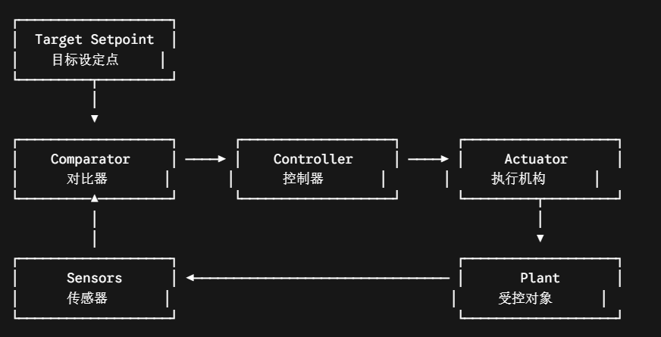
Closed-Loop Control Systems

Slide 4
Map to Harness Engineering
We use coding agent as an example:
Closed Loop Control | Harness Engineering | examples
Target Setpoint | user intent or prompt | develop some features
Comparator | verify if user intent is done | LLM judge
Actuator | tools that empower LLM | read, write, search, pytest
Plant | the environment | code base, sandbox that execute tools
Sensors | feedback for tool execution | logs or results of tool execution

Slide 5
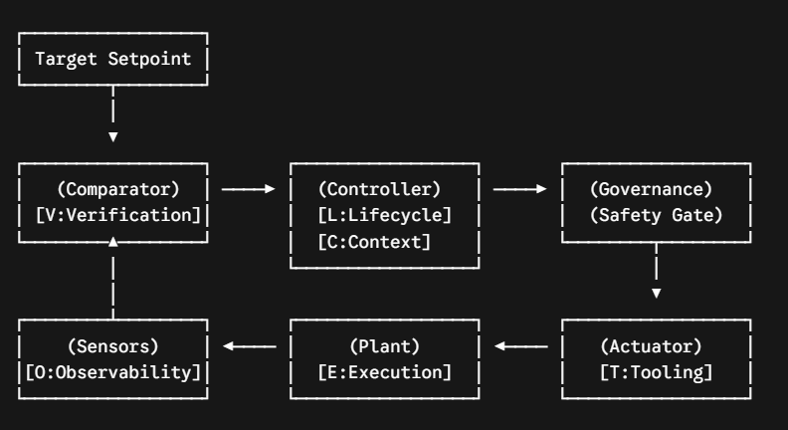
New Modules for Harness Engineering
Governance
LLM is a probabilistic generator and subject to prompt injection,
Cannot directly interact with env
Thus need to validate LLM output before actual execution
Lifecycle and Context
Similar to architect of computer
Lifecycle or Orchestration: CPU, determine what to do next (controller)
Context: RAM, record the data (state)

Slide 6
Summary of ETCLOVG Framework
Harness Layer (ETCLOVG) | Control Theory Component | Core Engineering Function
Execution Environment & Sandbox | The Plant | The isolated compute space (e.g., Docker) where actions physically execute.
Tool Interface & Protocol | The Actuator | Translates the controller's digital intentions into valid external API or system actions.
Context & Memory Management | The State Estimator | Filters out background noise, feeding the model only the vital active state variables.
Lifecycle & Orchestration | The Main Controller Clock | The deterministic state-machine loop driving the operational timeline (Think -> Act -> Read).
Observability & Operations | The Sensors | Passively logs, traces, and metrics execution paths and token telemetry.
Verification & Evaluation | The Comparator | Evaluates outputs against tests to calculate error, routing corrections back into the loop.
Governance & Security | The Saturation Limiter | Intercepts commands and revokes permissions if the system violates safety boundaries.

Slide 7
Orchestration Today
No complex workflow
Trust the reason ability of LLM
So the modern structure is just a closed loop control that
LLM to determine to what to do next
the harness executes the tools and return the results to LLM

Slide 8
Comparator(Verification)
The Stateless, Contract-First Filter
Seperation of genertor and evaluator
Confirmation bias: LLM tends to believe in what it output
Token cost inflation: the evaluator doesn’t need the history. A clean context will make the evalutor fast, unbiased and save tokens
Contract-first
Semantic drift, especially for hard task that run for many turns, the LLM will cheat and finish
Let the generator and evaluator to agree on what to implement and measures of completion at the beginning of the session

Slide 9
Governance
Seperation of LLM output and tool execution
LLM output is probabilistic and hence not reliable, use deterministic tool instead
Validate LLM output before sending for tool execution
Permission management, etc
Seperation of tool execution with real code base
Sandbox
The wrong execution would not ruin the real environment

Slide 10
Tools and Observability for a Coding Agent
Observability: just results of tool execution
Tools
Discovery, e.g. directory maps, codebase grep, file readers
Mutation, e.g. write, modify, insert
Validation, e.g. pytest, npm test
Extension: why it is hard for LLM to win in real world application, e.g. finance, law, medicine
The key point is observability.
For coding, the env is standard, you can easily get the feedback by running the code in sandbox
For law, it is hard to determine whether a writing of contract is right. Maybe it's just a precedent and if you change the writing to a more fluent way, it failed.

Slide 11
Context Management
Make the primary converstion log high signal
To avoid context rot and behavioral drift
Save money
The history is clean and short
The history is well arranged to leverage the cache mechanism

Slide 12
Layer A: Primary Workspace Pristineness
Deterministic Token Ordering: The harness serializes the system prompt from most-stable to least-stable data types (Static Rules -> Tool Catalogs -> Project Specs -> Dialogue History). This locks down the top segment of the prompt sequence, ensuring it remains permanently warm in the provider's server-side Key-Value (KV) prefix cache to slash API latency and costs.
The Progress Artifact (plan.json): Instead of allowing the agent to track its to-do list in conversational text, the harness anchors the state to a structured JSON checklist on the local file system. The model reads and updates this file explicitly, offloading massive cognitive weight from the prompt.
Context Re-Hydration & Amnesia Mitigation: When a context window nears its limit, the harness flushes the LLM session, initializes a clean API container, and re-hydrates the state using only the current codebase state and the plan.json. To prevent the model from repeating past mistakes due to the resulting "history amnesia," the harness tracks a local Directed Acyclic Graph (DAG) of rejected hypotheses and injects them as hard negative constraints.

Slide 13
Layer C: Sub-Agent Isolation (The Context Firewall)
Key: Seperation of main agent and sub-agent’s context and only pass needed information
Hyper-Narrow Mandates: The main harness spawns short-lived, isolated sub-agent containers stripped of unnecessary tools and global context, limiting their access to the narrow scope of the micro-task.
Schema-Driven Return Boundaries: Sub-agents are blocked from returning open-ended text or raw chat logs to the lead agent. They must pass their final breakthrough through a strict local validation schema (e.g., a Pydantic object mapping exactly to status, root_cause_summary, and proposed_patch).
Scratchpad Erasure: The moment the sub-agent satisfies the validation schema, the harness copies the clean JSON object back into the lead context window and completely erases the sub-agent’s entire terminal, log, and token history from RAM. The lead agent gets the distilled solution without inheriting the 200,000 tokens of messy exploration logs.

Slide 14
Layer B: Tool-Call Telemetry Dieting
Similar to sub-agent case, but here we cannot control the output of tools.
Noise Striping: Running local, sub-millisecond regex passes to strip out installer progress bars, redundancy trees, and routine success logs before tokens are spent.
Deterministic High-Entropy Interval Detection:
Rather than relying on a naive top/bottom crop or forcing the LLM into a high-latency guessing game of paginated reads, the harness locally scans the command stdout to isolate chunks of unexpected or irregular token distributions (such as sudden clusters of tracebacks, hex codes, or warning flags). This local pass calculates the exact start and end lines bounding this high-entropy data interval.
By serving the model only the text contained within this bounded failure zone, the harness saves tokens based on structural probability. It isolates the exact error signals while filtering out the predictable success metrics surrounding them.
The Index-and-Pointer Pattern: For massive logs, the harness hides the bulk payload entirely and passes a compressed metadata virtual pointer containing the extracted high-entropy line indices:
[SYSTEM]: Output exceeded 20KB. High-entropy error interval detected between lines 2410 and 2465. Full log cached at /tmp/build.log. Use read_log_bounds(start=2410, end=2465) to inspect.

Slide 15
Layer D: Dynamic Tool Loading & Registry Pruning
Lifecycle Phase Gating
Use different set of tools in different phase (discovery, mutation, validation)
Just-In-Time (JIT) Pre-Flight Routing
Before the primary reasoning model processes a task, the user intent is parsed by an ultra-fast, local flash model acting as an infrastructure traffic cop. This router model does not execute the objective; its sole job is to emit a clean array of required tool domains. The harness intercepts this array, hydrates the context window exclusively with those matching schemas from the registry, and passes the clean, low-overhead payload to the primary model.
Semantic Embedding Retrieval
When managing thousands of bespoke enterprise APIs, hardcoded classification breaks down. The harness vectorizes the functional text descriptions of every tool in the registry and stores them in a local vector space. At the start of a processing turn, the current state and error logs are used to run a local similarity search, injecting only the top 5 to 10 most relevant tool definitions into the active prompt window.

Slide 16
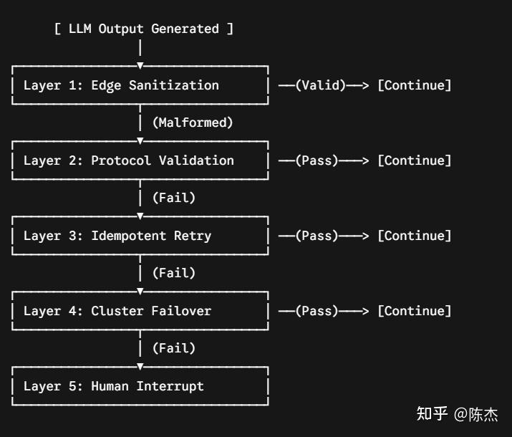
Reasonix’s Design on Model Esculation
Example: how harness does when LLM outputs malformed syntax
This is to show
Harness prefers deterministic actions
a system design example of a harness task
reasonix’s strategy to save money

Slide 17
Layer 1 & 2
Layer 1: Edge Data Sanitization (Local, <1ms)
System Analogy:Edge Node Data Sanitization
The Mechanism: The moment a lower-tier model (e.g., DeepSeek-V4-Flash) returns a response, the harness intercepts it locally using Abstract Syntax Tree (AST) or regular expression parsers.
The Logic: If the foundational logic is intact but wrapped in minor structural defects (e.g., clipped JSON wrappers or missing closing XML tags), the harness repairs the envelope instantly on the client side. The execution proceeds smoothly, leveraging the warm cache of the flash model without notifying the external environment of a fault.
Layer 2: Protocol & Schema Validation (Local, <20ms)
System Analogy:Protocol Compliance Verification
The Mechanism: The sanitized payload is passed to local linters, type checkers, or strict compiler validation tools.
The Logic: This layer confirms the structural and logical integrity of the generated output. If the code compiles or matches the schema exactly, it is approved for execution. If the compiler returns a hard failure, the system immediately flags the flash model's response node as corrupted and escalates the fault.

Slide 18
Layer 3 & 4
Layer 3: Idempotent Retry with Context Mutation (Remote, Seconds)
System Analogy:Stateful Transient Exponential Backoff
The Mechanism: The harness clears the mangled output block, appends a precise, localized error payload to the end of the prompt sequence, and requests a single-shot regeneration from the flash model (max_retries = 1).
The Logic: Because the upstream cache prefix remains perfectly locked, a localized retry is incredibly fast and cheap. Given the low cost profile of flash models, giving the model one immediate, well-contextualized chance to correct its mistake is highly cost-effective.
Layer 4: Cross-Cluster Failover to Premium Service (Remote, High Cost)
System Analogy:Circuit Breaking with Premium Cluster Routing
The Mechanism: If the flash model fails to pass validation after a localized retry, it signals that the underlying task complexity has broken through the cognitive ceiling of the lower-cost tier. The harness cuts the execution track and transparently migrates the clean, uncorrupted historical prefix to a high-cognition model tier (e.g., DeepSeek-V4-Pro / R1 reasoning chains).
The Logic: The premium reasoning engine completely restructures the logic to break the dead-end. To prevent costly, repetitive ping-ponging between model tiers, the harness locks the execution track to the Pro model for the remainder of that specific task's lifecycle.

Slide 19
The Comparator Trap in High-Stakes Domains
State Observability vs. Action Evaluation
The Misconception: High-liability industries do not lack state visibility; we have real-time market tickers, comprehensive patient charts, and exhaustive legal databases.
The Real Bottleneck: The system collapses at the Comparator Layer—the mechanism responsible for calculating the error delta between an agent's action and the target setpoint.
The Decoupling: In coding, the Sensor and Comparator are tightly coupled via the console output. In semantic domains, they are completely fractured.

Slide 20
The Missing Enterprise "Compiler"
Finance: No native finance-compile exists to instantly evaluate whether an unstructured, cross-border asset-allocation strategy contains an implicit compliance breach.
Law: No automated pytest can flag that an open-ended phrasing change on page 90 has silently nullified an indemnity waiver on page 12.
Medicine: No low-cost, zero-risk sandbox exists to run a clinical triage recommendation where a minor miscalculation wouldn't result in immediate human liability.

Slide 21
Empirical Proof: The "Read-Only" Stagnation
The Glass Ceiling: Current enterprise GenAI deployment is heavily bottlenecked at low-risk, peripheral use cases like RAG chatbots, OCR document parsing, and Tier-1 customer support.
The Missing Sensor: These applications dominate because they are "read-only" or low-stakes tasks where a human supervisor is forced to act as the missing closed-loop sensor.
The Automation Wall: Moving from passive "reading" to autonomous "writing" (taking irreversible actions) causes systems to collapse because the underlying harness layer is completely blind to its environment.

Slide 22
Why Traditional Feedback Loops Fail Here
Catastrophic Feedback Delay: Real-world enterprise feedback has massive latency (investment returns take months; legal clauses take years to face a lawsuit). In control theory, high latency introduces severe system oscillation and instability.
The Self-Evaluating Death Spiral: Lacking a native compiler, developers fall back on letting the LLM evaluate its own output, making the generator its own judge.
Cognitive Failure Modes: This triggers severe Confirmation Bias (the model confidently approves its own flaws) and Token Cognitive Drift (the model loses track of the target setpoint over multi-turn interactions).

Slide 23
Conclusion: Harness as the Risk-Breaker
1. Shifting Focus to Proxy Simulators
Beyond Model Cognition: Upgrading to a "smarter" foundational LLM or writing longer prompts will not rescue a system trapped in an evaluation vacuum.
Shortening the Loop: Because real-world feedback is severely delayed, the harness must construct high-frequency, local Proxy Simulators (e.g., automated historical backtesting engines or graph-based contract dependency linters) to artificially shorten latency.
2. Guardrails Over Absolute Judgment
The True Role of the Harness: The goal of Harness Engineering in semantic fields is not to prove that an LLM's decision is the "absolute optimal strategy."
The Risk Breaker: The harness must serve as a deterministic risk breaker and safety guardrail designed to 100% rule out catastrophic failure modes.
Enforcing Invariants: The harness does not need to understand medical brilliance or legal prose; it simply uses hardcoded invariant constraints and strict schema firewalls (e.g., Pydantic objects) to intercept and kill a tool call if it violates a critical safety boundary.

Slide 24
Reference
agent harness engineering-a survery
From Prompts to Autopilot: Why "Harness Engineering" is the True Key to LLM Reliability
The Algorithm of Compute: Why Modern Agent Harnesses Focus 80% of Their Design on Context Management
Beyond the Echo Chamber: Engineering Resilient LLM Agent Harnesses
The Systems Engineering of LLM Context Management
Harness as an OS: Architectural Musings on Reasonix
The Observability Trap: Why High-Stakes AI Fails

